Slide 1
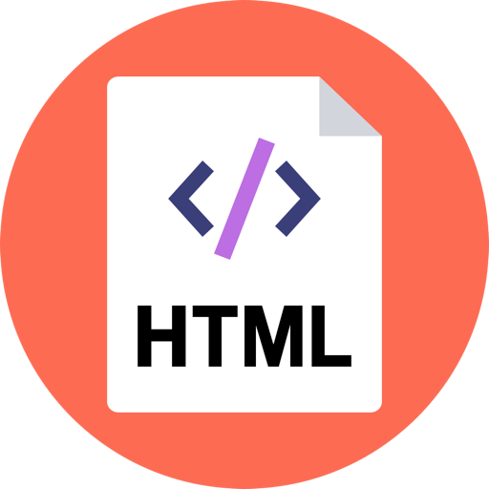
Amuthan Arulraj

Slide 2
Hypertext Markup Language
Fundamental technology used to define the structure of a webpage.
HTML is not a programming language, it is a markup language used to tell your browser how to structure the webpages you visit.
HTML consists of a series of elements, which you use to enclose, wrap, or mark up different parts of the content to make it appear or act a certain way
Notes:
HTML is used to specify whether your web content should be recognized as a paragraph, list, heading, link, image, multimedia player, form, or one of many other available elements or even a new element that you define.

Slide 3
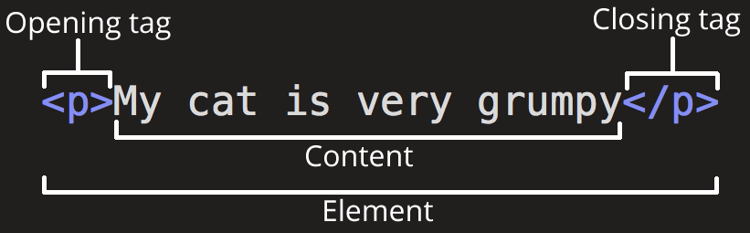
Elements
Notes:
The opening tag: This consists of the name of the element (in this case, p), wrapped in opening and closing angle brackets. This states where the element begins, or starts to take effect — in this case where the start of the paragraph is.
The closing tag: This is the same as the opening tag, except that it includes a forward slash before the element name. This states where the element ends — in this case where the end of the paragraph is. Failing to include a closing tag is a common beginner error and can lead to strange results.
The content: This is the content of the element, which in this case is just text.
The element: The opening tag plus the closing tag plus the content equals the element.

Slide 4
Elements
Elements can be nested: one element can be put inside another element.
Block elements form a visible block on a page — they will appear on a new line from whatever content went before it, and any content that goes after it will also appear on a new line. Block-level elements tend to be structural elements on the page that represent, for example, paragraphs, lists, navigation menus, footers, etc. A block-level element wouldn't be nested inside an inline element, but it might be nested inside another block-level element.
Inline elements are those that are contained within block-level elements and surround only small parts of the document’s content, not entire paragraphs and groupings of content. An inline element will not cause a new line to appear in the document; they would normally appear inside a paragraph of text, for example an <a> element (hyperlink) or emphasis elements such as <em> or <strong>.
Empty Elements: Some elements consist only of a single tag, which is usually used to insert/embed something in the document at the place it is included

Slide 5
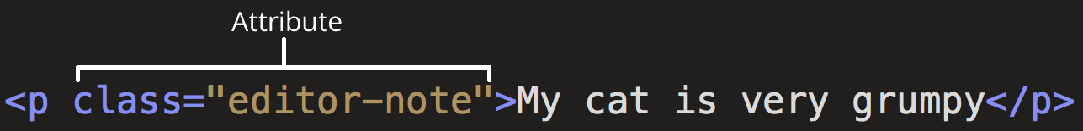
Attributes
Attributes contain extra information about the element which you don't want to appear in the actual content

Slide 6
Attributes
Attributes contain extra information about the element which you don't want to appear in the actual content.
An attribute should have:
A space between it and the element name.
The attribute name, followed by an equals sign.
An attribute value, with opening and closing quote marks wrapped around it.

Slide 7
Boolean Attributes
You'll sometimes see attributes written without values — this is perfectly allowed. These are called boolean attributes, and they can only have one value, which is generally the same as the attribute name.
<input type="text" disabled="disabled">
<input type="text" disabled> <input type="text">

Slide 8
Attributes Coding Style
Attribute values can omit quotes but its a bad code style. It also breaks if there are more than one attribute in the element.
Either single or double quotes can be used. But double quotes are commonly used.

Slide 9
Anatomy of an HTML document
<!DOCTYPE html> <html> <head> <meta charset="utf-8"> <title>My test page</title> </head> <body> <p>This is my page</p> </body> </html>

Slide 10
Whitespaces
<p>Dogs are silly.</p> <p>Dogs are silly.</p>
But whitespaces can be used for code readability.

Slide 11
Entity References
In HTML, the characters <, >,",' and & are special characters. They are parts of the HTML syntax itself, so it cannot be used in the content.
< = &lt; > = &gt;
" = &quot;
' = &apos; & = &amp;
<p>In HTML, you define a paragraph using the <p> element.</p> <p>In HTML, you define a paragraph using the &lt;p&gt; element.</p>

Slide 12
HTML Comments
<p>I'm not inside a comment</p> <!-- <p>I am!</p> -->

Slide 13
<meta>
Meta tag provides metadata about the page.
Common attributes
name
property
content
charset
author
description

Slide 14
<table>
Table tag represents tabular data — that is, information presented in a two-dimensional table comprised of rows and columns of cells containing data.
Common elements
tr
td
th
colgroup
tbody
thead
tfoot

Slide 15
<form>
Table tag represents a document section that contains interactive controls to submit information to a web server.
Attributes
Action
method
Common elements
label
input
select
datalist
textarea

Slide 16
Self Study
article
details
header
footer
nav
section
wbr
audio
video

Slide 17
<svg>
Scalable Vector Graphics (SVG) is an XML-based markup language for describing two dimensional based vector graphics. SVG is essentially to graphics what HTML is to text.

Slide 18
<canvas>
Canvas element can be used to draw graphics via scripting in JavaScript. For example, it can be used to draw graphs, make photo compositions, create animations, or even do real-time video processing or rendering.

Slide 19
Web Components
Web Components is a suite of different technologies allowing you to create reusable custom user interface components — with their functionality encapsulated away from the rest of your code — and utilize them in your web apps.

Slide 20
References
https://developer.mozilla.org/en-US/docs/Web/HTML
https://www.w3schools.com/html/default.asp
https://www.w3.org/TR/html52/

